Slide 1
Pause for Breath
Notes:
Pause for Breath
This is an invitation to take some time to reflect before resuming decision making or regular congregational activities as lockdown restrictions ease. All of us have had our normal lives traumatically interrupted. All of us have experienced grief and loss and for some of us the loss of loved ones in difficult circumstances will take a long time to come to terms with.
There is a temptation to rush to problem solving and decision making.
There is a lot of evidence, however, that as decision makers in times of great uncertainty we benefit from allowing ourselves to be aware of our feelings and to listen to one another.
Pause for Breath is a guided conversation which last about an hour and a half, and gives opportunity to reflect on your situation as individuals and as a congregation.
It touches on the process of transition, especially when we don’t know what the ‘new normal’ will be like.

Slide 2
How are you?
What has lockdown been like for you?
What/who is on your mind?
This Photo by Unknown Author is licensed under CC BY
Notes:
Small group conversation (15 minutes)
In groups of 4 or 5 take time to let everyone speak, just to tell one another the story of what life has been like since the collective effort to stop the spread of Covid 19 brought everything to a halt.
‘Lockdown’ is being used as a catchall for the past 6 months, but some people have not been locked down at all because of their roles as key workers, and some will continue to self isolate even as restrictions lift. Each of us is different, and this is an opportunity for everyone to be heard.

Slide 3
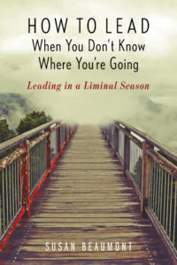
Notes:
This is the cover of a book called ‘How to lead when you don’t know where you’re going’ by Susan Beaumont. It was written before Covid19. It comes out of experience of working with church leaders who know that things need to change, but can’t imagine what they need to change to. Covid 19 has highlighted this uncertainty because ‘normal’ church life stopped dramatically almost overnight, and new ways to worship and share fellowship and serve local communities had to be found.
We are in what Susan Beaumont and others have called a liminal space: an inbetween space.
We have left what is familiar and we cannot yet imagine what lies ahead.
It is our role as leaders (ministers, deacons, MDS, elders and board members) to plan, but leadership when we don’t know where we are going is less about making decisions and managing change and more about holding the anxiety and disorientation we all feel and coming to God with it, seeking God’s guidance.

Slide 4
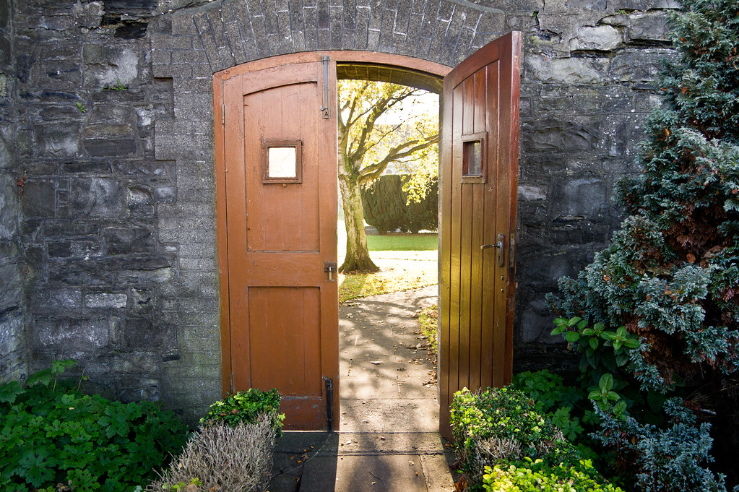
This Photo by Unknown Author is licensed under CC BY-SA
Notes:
The adjective liminal comes from the Latin for threshold.

Slide 5
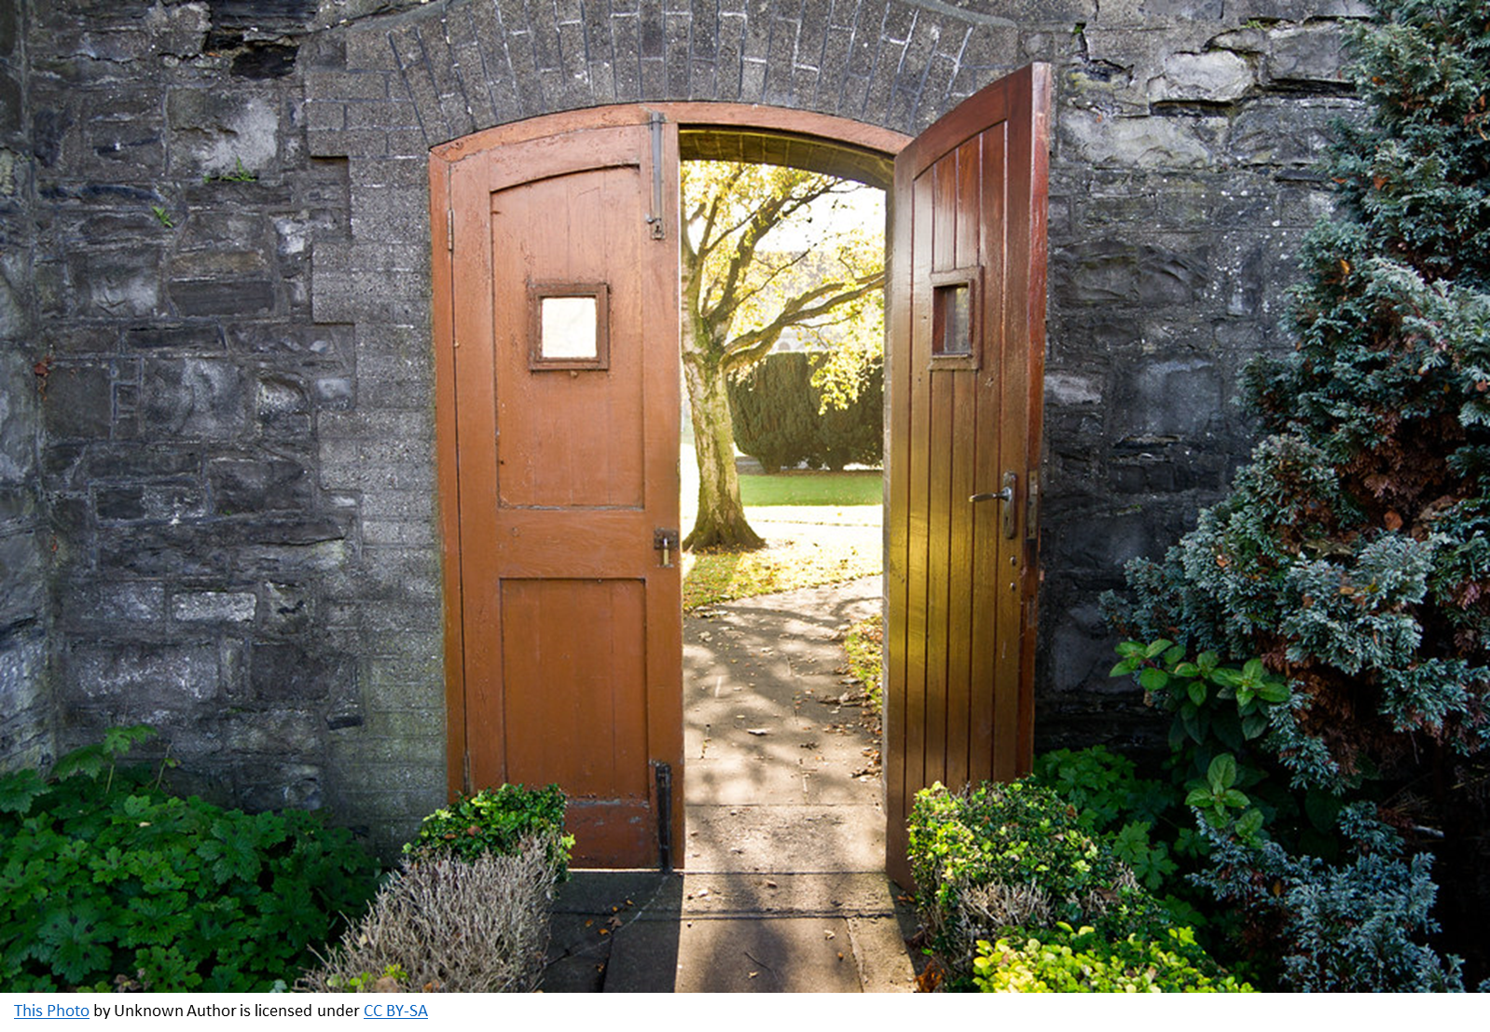
liminal
Pronunciation /ˈlɪmɪn(ə)l/
Relating to a transitional or initial stage of a process.
Occupying a position at, or on both sides of, a boundary or threshold.
Notes:
It is literally the place between, the boundary between the old and the new.
The past six months have been an extended liminal space, where we have been stuck between the old and the new, and have no clear sense yet of what the ‘new‘ will be like.
Without an effective vaccine and unless track and trace works well to minimise spikes in the virus , ‘normal’ will be very different.
Beaumont and others see this liminal space as being not just a threshold between two different spaces, but much more dramatically.
They use the metaphor of the trapeze artist.

Slide 6
Notes:
You have to let go of the one bar as you reach out to the next bar. You literally have to reach out in faith.
In small groups we are going to think about what we are letting go of and what we are reaching out for.

Slide 7
What has been lost because of Covid 19?
What has been gained because of Covid 19?
Notes:
First of all, we are thinking about where we have come from, looking back to the time before Covid19. and we are acknowledging that there have been gains as well as losses in this time.
There are two questions to consider. It would be helpful if someone took some notes (if on Zoom this could be in the Chat function) to report back to the whole group.
Take 15 minutes to share, and then depending on how many groups there are, plenty time to report back.

Slide 8
From a personal perspective, what might you want to do differently, going forward?
In terms of congregational life, what do you think needs to be done differently?
Notes:
Now, having acknowledged the different feelings and losses and gains, we begin to look ahead.
The first is personal, and again, it would be good to hear from everyone in your small group.
The second is not so much asking about the details of ‘how’ things will be done, but invites reflection on what there might be an opportunity to change. It might be as prosaic as how the offering is collected, but it might be much more existential, ‘What gives us joy, such that we’d like more it?’ ‘What drains us, and how do we reduce it?’
Again, it would be helpful if someone took some notes (if on Zoom this could be in the Chat function) to report back to the whole group.
Take 20 minutes to share, and then depending on how many groups there are, plenty time to report back.

Slide 9
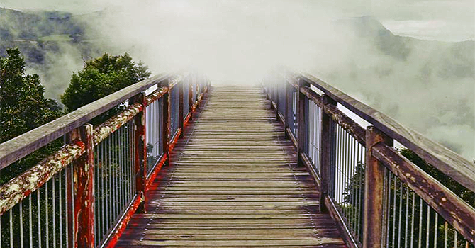
‘How to lead when you don’t know where you are going’
by Susan Beaumont
Notes:
Uncertainty and impermanence are not only experienced in liminal times. They are part of the human condition. Our forebearers in faith, time and again, set out without knowing where they are going, and needed to trust God.
Or they were propelled into a new existence, like exile in Babylon, and had to deal with what this revealed about themselves and their relationship with God.
While these feel like particularly uncertain times, perhaps the truth is we are just more aware of our common human experience.
And perhaps our increased awareness can help us be more reliant on God. The people of Israel were in the wilderness for 40 years! Perhaps we are being asked to explore this liminal place a bit longer as we try to discern where God is at work, and join in.
Susan Beaumont puts it like this:

Slide 10
The starting point of any kind of transition is not the outcome you are moving toward but the ending you must make to leave the old situation behind.
Liminality is simultaneously dangerous, alluring and sacred.
You let go of one trapeze with the faith that the new trapeze is on its way. In the meantime there’s nothing to hold onto.
Notes:
‘Good endings’ require taking time, exploring and expressing feelings and devising rituals to move towards what we have come to call ‘closure’.
As you make decisions about your future, in the context of a changing situation in society and the national church it will be important to explore together what is being left behind by choice and by necessity.
It will be uncomfortable and challenging as well as potentially exciting. As Beaumont puts it, ‘Liminality is simultaneously dangerous, alluring and sacred.’ (p11)
Our whole world and our society seems in transition, and as faith communities the church is asked to hold the sacred space, to remember God’s priorities for justice and inclusion and to proclaim our hope in the One who said, ‘I will be with you always, to the end of the age.’ (Matt 28:20)

Slide 11
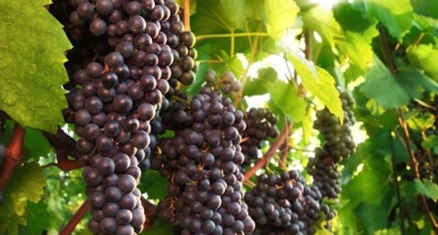
On one occasion the followers of John the Baptist and the Pharisees were fasting. Some people came to Jesus and asked him, ‘Why is it that the disciples of John the Baptist and the disciples of the Pharisees fast, but your do not?’
Jesus answered, ‘Do you expect the guests at a wedding party to go without food? Of course not! As long as the bridegroom is with them, they will not do that. But the day will come when the bridegroom will be taken away from them, and then they will fast.
Notes:
At a recent Zoom induction, Dan Carmichael, the moderator of Presbytery at that time, led a reflection on Mark 2:18-22. He told a story which unpacked Jesus’ illustration of the new wine in new wineskins, which may stimulate you to wonder further about what the Spirit is saying to the churches.
Here is the text from Mark 2:18-22

Slide 12
No-one uses a piece of new cloth to patch up an old coat, because the new patch will shrink and tear off some of the old cloth, making an even bigger hole.
Nor does anyone pour new wine into used wineskins, because the wine will burst the skins, and both the wine and the skins will be ruined. Instead, new wine must be poured into fresh wineskins.’ Mark 2:18-22
Notes:
At a recent Zoom induction, Dan Carmichael, the moderator of Presbytery at that time, led a reflection on Mark 2:18-22. He told a story which unpacked Jesus’ illustration of the new wine in new wineskins, which may stimulate you to wonder further about what the Spirit is saying to the churches.
Here is the text from Mark 2:18-22

Slide 13
Notes:
Let’s try to picture a small winemaking business in the time of Jesus. Rows of vines, a dozen, couple of dozen of them stretching up a hillside, with a house and some sheds below. It’s a family thing – the old couple leaning against a wall, their tired hands tell of season after season of planting and pruning, harvesting and pressing, tasting and storing. They’ve passed on all they know to the children and their children’s children. They eek out a living, they get by and folk in the village depend on them for wine and a bit of work.

Slide 14
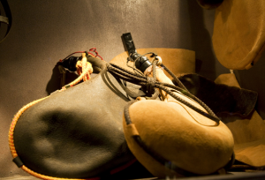
This Photo by Unknown Author is licensed under CC BY
Notes:
A new year’s vintage is ready…Someone goes into the cupboard where the leather skins are ready to be filled with the new wine. They count the skins…perhaps not enough…I’ll need to get to the village and see if I can get a couple more. But at the bottom of the shelf a few old ones, cracked worn shrunk a bit. They hear the old couple… ‘Never put new wine in old wineskins.’
‘…och it won’t matter, a couple old wineskins will do. They’ll see out another year surely?’
And the next day in the dark storeroom, the smell of wine, the trickle under the door, the waste…and the look in the faces of the old couple, the young children, the workers from the village…that’s most of this year’s profit gone. They all lose out. The waste. Why?

Slide 15
Notes:
Jesus spoke about wine and wineskins in the context of a debate about fasting. It wasn’t that he objected to the fasting the Pharisees and John’s disciples were observing, probably to remember a low point in Israel’s history like the exile into Babylon. No, his point – a bit like Ecclesiastes chapter three and a time for everything under the sun, the time when the Son of God is teaching and healing is a wedding like celebration, not a fast. It’s about God’s times and seasons – and if you’re out of step with God’s timing- you risk pouring the renewing love and power of the Spirit down the drain. So as God’s children – leaders of Christ’s Church of Scotland business in Glasgow, what is God teaching us about the time we’re in and how we should respond? This is crucial. Probably this is a wine, wineskin moment and we only get one go at making our choices.
Seek, search, ask…
What is God wanting to use this Presbytery (this congregation) for now? What are we not going to take with us as we walk with Jesus into the years ahead?
This conversation might be continued in small groups, or reflected on before the next meeting and picked up then.

Slide 16
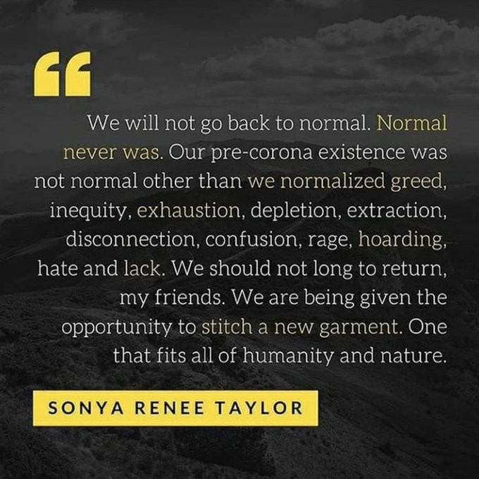
Notes:
And because it is always good to remind ourselves that God’s dream for Creation is Creation renewed and that the Church is a partner in that mission and not the end of that mission, it might be good to finish with a quotation from an African American activist who reminds us that ’normal’ was never normal:
‘We will not go back to normal. Normal never was. Our pre-corona existence was not normal other than we normalised greed, inequity, exhaustion, depletion, extraction, disconnection, confusion, rage, hoarding, hate and lack. We should not long to return, my friends. We are being given the opportunity to stitch a new garment. One that fits all of humanity and nature.’
We are being given the opportunity to stitch a new garment.
It is for us in (NAME church) to work out what that means for us here and now.

